Slide 1


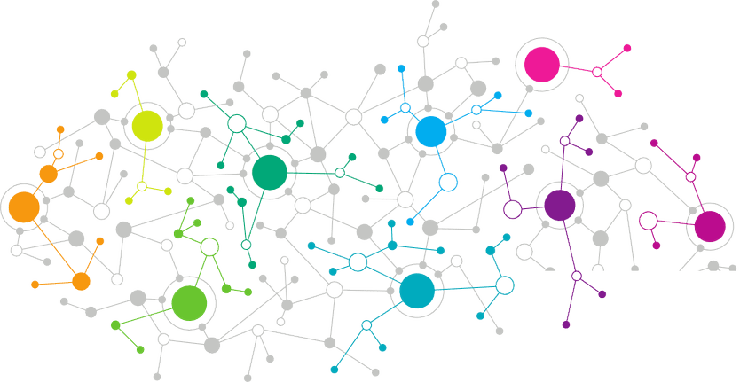

Data Science
Data Cleansing
Notes:
Welcome back to the forth module of data science.

Slide 2

Data Cleansing
When dealing with real world data, you have to keep in mind that it is extremely untidy. It will not have a proper structure and hence this is where data cleansing comes in to bring proper structure to this data.
Notes:
The first question that arise in our mind is why Statistics?
Let me make you clear that Statistics is one of the key fundamental skills required for data science. Moving forward in the data science, if you go for any kind of algorithms then primarily knowledge in statistics is quite important. Actually, the statistics and probability are considered as the base knowledge and they are very essential for moving into any machine learning algorithms.

Slide 3
Data Cleansing
These are some of the actions which you’d have to take during data cleansing process:
Giving proper names to columns
Checking for whitespaces in data
Grouping of similar data into same levels
Handling missing values(Imputation)
Notes:
The first question that arise in our mind is why Statistics?
Let me make you clear that Statistics is one of the key fundamental skills required for data science. Moving forward in the data science, if you go for any kind of algorithms then primarily knowledge in statistics is quite important. Actually, the statistics and probability are considered as the base knowledge and they are very essential for moving into any machine learning algorithms.

Slide 4
Data Cleansing on ‘Census’ Data
Notes:
So, lets look at some of the commonly used Statistical Terminology in data science.

Slide 5
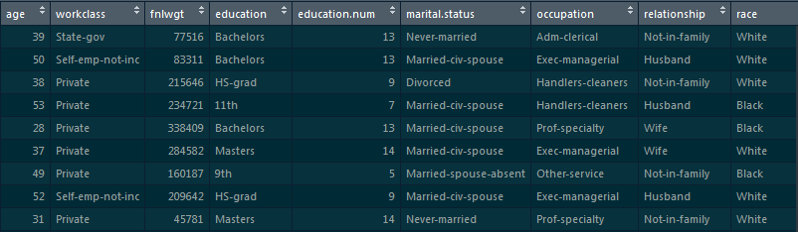
Census Data
This census data has 32561 rows and 15 columns
Notes:
The first question that arise in our mind is why Statistics?
Let me make you clear that Statistics is one of the key fundamental skills required for data science. Moving forward in the data science, if you go for any kind of algorithms then primarily knowledge in statistics is quite important. Actually, the statistics and probability are considered as the base knowledge and they are very essential for moving into any machine learning algorithms.

Slide 6

Data Cleansing Steps – Renaming Columns
Renaming the age column:
colnames(census)[colnames(census)=="age"]<-"Age"
Notes:
The first question that arise in our mind is why Statistics?
Let me make you clear that Statistics is one of the key fundamental skills required for data science. Moving forward in the data science, if you go for any kind of algorithms then primarily knowledge in statistics is quite important. Actually, the statistics and probability are considered as the base knowledge and they are very essential for moving into any machine learning algorithms.

Slide 7


Data Cleansing Steps – Renaming Columns
Renaming ‘workclass’ column:
library(data.table)
setnames(census, "workclass", "Employment-Type")
Notes:
The first question that arise in our mind is why Statistics?
Let me make you clear that Statistics is one of the key fundamental skills required for data science. Moving forward in the data science, if you go for any kind of algorithms then primarily knowledge in statistics is quite important. Actually, the statistics and probability are considered as the base knowledge and they are very essential for moving into any machine learning algorithms.

Slide 8


Data Cleansing Steps – Renaming Columns
Renaming ‘fnlwgt’ column:
library(plyr)
census<-rename(census,c('fnlwgt'='Final-Weight'))
Notes:
The first question that arise in our mind is why Statistics?
Let me make you clear that Statistics is one of the key fundamental skills required for data science. Moving forward in the data science, if you go for any kind of algorithms then primarily knowledge in statistics is quite important. Actually, the statistics and probability are considered as the base knowledge and they are very essential for moving into any machine learning algorithms.

Slide 9


Data Cleansing Steps – Renaming Columns
Renaming ‘education’ column:
library(gdata)
census <- rename.vars(census, from = "education", to = "Education")
Notes:
The first question that arise in our mind is why Statistics?
Let me make you clear that Statistics is one of the key fundamental skills required for data science. Moving forward in the data science, if you go for any kind of algorithms then primarily knowledge in statistics is quite important. Actually, the statistics and probability are considered as the base knowledge and they are very essential for moving into any machine learning algorithms.

Slide 10
Data Cleansing Steps – Renaming Columns
Renaming rest of the columns:
setnames(census, "education.num", "Education-Number")
setnames(census, "marital.status", "Marital-Status")
setnames(census, "occupation", "Occupation")
setnames(census, "relationship", "Relationship")
setnames(census, "race", "Race")
setnames(census, "sex", "Sex")
setnames(census, "capital.gain", "Capital-Gain")
setnames(census, "capital.loss", "Capital-Loss")
setnames(census, "hours.per.week", "Hours-Per-Week")
setnames(census, "native.country", "Native-Country")
setnames(census, "X", "Income")
Notes:
The first question that arise in our mind is why Statistics?
Let me make you clear that Statistics is one of the key fundamental skills required for data science. Moving forward in the data science, if you go for any kind of algorithms then primarily knowledge in statistics is quite important. Actually, the statistics and probability are considered as the base knowledge and they are very essential for moving into any machine learning algorithms.

Slide 11

Data Cleansing Steps – Collapsing Levels
Many times a categorical column has levels which represent the same thing. So, in this case, the repetitive levels could be collapsed into a common level. There are also chances where multiple levels which come under the same category can be grouped under an umbrella level
Notes:
The first question that arise in our mind is why Statistics?
Let me make you clear that Statistics is one of the key fundamental skills required for data science. Moving forward in the data science, if you go for any kind of algorithms then primarily knowledge in statistics is quite important. Actually, the statistics and probability are considered as the base knowledge and they are very essential for moving into any machine learning algorithms.

Slide 12
Data Cleansing Steps – Collapsing Levels
In ‘Employment-Type’ column, collapsing “State-gov”, “Federal-gov” & “Local-gov” into “Government”.
Also, collapsing ‘Self-emp-inc’ & ‘Self-emp-not-inc’ into “Self Employed”
table(census$`Employment-Type`)
as.character(census$`Employment-Type`) -> census$`Employment-Type`
census$`Employment-Type`[census$`Employment-Type`==" State-gov"] <- "Government"
census$`Employment-Type`[census$`Employment-Type`==" Federal-gov"] <- "Government"
census$`Employment-Type`[census$`Employment-Type`==" Local-gov"] <- "Government"
census$`Employment-Type`[census$`Employment-Type`==" Self-emp-inc"] <- "Self Employed"
census$`Employment-Type`[census$`Employment-Type`==" Self-emp-not-inc"] <- "Self Employed"
Notes:
The first question that arise in our mind is why Statistics?
Let me make you clear that Statistics is one of the key fundamental skills required for data science. Moving forward in the data science, if you go for any kind of algorithms then primarily knowledge in statistics is quite important. Actually, the statistics and probability are considered as the base knowledge and they are very essential for moving into any machine learning algorithms.

Slide 13
Data Cleansing Steps – Collapsing Levels
In ‘Marital-Status’ column, collapsing ‘Married-AF-spouse’, ‘Married-spouse-absent’, & ‘Married-civ-spouse’ into “Married”
table(census$`Marital-Status`)
as.character(census$`Marital-Status`) -> census$`Marital-Status`
census$`Marital-Status`[census$`Marital-Status`== " Married-AF-spouse"] <- "Married"
census$`Marital-Status`[census$`Marital-Status`== " Married-spouse-absent"] <- "Married"
census$`Marital-Status`[census$`Marital-Status`== " Married-civ-spouse"] <- "Married“
Notes:
The first question that arise in our mind is why Statistics?
Let me make you clear that Statistics is one of the key fundamental skills required for data science. Moving forward in the data science, if you go for any kind of algorithms then primarily knowledge in statistics is quite important. Actually, the statistics and probability are considered as the base knowledge and they are very essential for moving into any machine learning algorithms.

Slide 14
Data Cleansing Steps – Collapsing Levels
In ‘Native-Country’ column, collapsing different levels into “Europe”:
table(census$`Native-Country`)
as.character(census$`Native-Country`) -> census$`Native-Country`
census$`Native-Country`[census$`Native-Country`== " England"] <- "Europe"
census$`Native-Country`[census$`Native-Country`== " France"] <- "Europe"
census$`Native-Country`[census$`Native-Country`== " Germany"] <- "Europe"
census$`Native-Country`[census$`Native-Country`== " Greece"] <- "Europe"
census$`Native-Country`[census$`Native-Country`== " Ireland"] <- "Europe"
census$`Native-Country`[census$`Native-Country`== " Scotland"] <- "Europe"
census$`Native-Country`[census$`Native-Country`== " Portugal"] <- "Europe"
census$`Native-Country`[census$`Native-Country`== " Italy"] <- "Europe"
Notes:
The first question that arise in our mind is why Statistics?
Let me make you clear that Statistics is one of the key fundamental skills required for data science. Moving forward in the data science, if you go for any kind of algorithms then primarily knowledge in statistics is quite important. Actually, the statistics and probability are considered as the base knowledge and they are very essential for moving into any machine learning algorithms.

Slide 15
Data Cleansing Steps – Collapsing Levels
In ‘Native-Country’ column, collapsing different levels into “Asia”:
census$`Native-Country`[census$`Native-Country`== " India"] <- "Asia"
census$`Native-Country`[census$`Native-Country`== " Vietnam"] <- "Asia"
census$`Native-Country`[census$`Native-Country`== " Taiwan"] <- "Asia"
census$`Native-Country`[census$`Native-Country`== " Japan"] <- "Asia"
census$`Native-Country`[census$`Native-Country`== " Thailand"] <- "Asia"
census$`Native-Country`[census$`Native-Country`== " Iran"] <- "Asia"
census$`Native-Country`[census$`Native-Country`== " China"] <- "Asia"
Notes:
The first question that arise in our mind is why Statistics?
Let me make you clear that Statistics is one of the key fundamental skills required for data science. Moving forward in the data science, if you go for any kind of algorithms then primarily knowledge in statistics is quite important. Actually, the statistics and probability are considered as the base knowledge and they are very essential for moving into any machine learning algorithms.

Slide 16
Data Cleansing Steps – Imputation
Wherever we have “ ?”, we’ll replace it with NA:
census[census == " ?"] <- NA
Creating function to count number of NA values:
na_count <-function (x) sapply(x, function(y) sum(is.na(y)))
na_count(census)
Notes:
The first question that arise in our mind is why Statistics?
Let me make you clear that Statistics is one of the key fundamental skills required for data science. Moving forward in the data science, if you go for any kind of algorithms then primarily knowledge in statistics is quite important. Actually, the statistics and probability are considered as the base knowledge and they are very essential for moving into any machine learning algorithms.

Slide 17
Data Cleansing Steps – Imputation
Omitting NA values:
census <- na.omit(census)
na_count(census)
Notes:
The first question that arise in our mind is why Statistics?
Let me make you clear that Statistics is one of the key fundamental skills required for data science. Moving forward in the data science, if you go for any kind of algorithms then primarily knowledge in statistics is quite important. Actually, the statistics and probability are considered as the base knowledge and they are very essential for moving into any machine learning algorithms.

Slide 18
Thank You
Notes:
And this brings us to the end of this session, thanks for attending & let’s meet in the next class!

